Slide 1
Dot Net Architecture Understanding

Slide 2
Agenda
.Net Architecture
.Net Languages(C#, VB. Net ,Asp.Net etc.)
Common Language Specification(CLS)
Common Type System(CTS)
Database and Web Applications (ADO.NET,ASP.NET,WinForms)
Common Language Runtime(CLR)

Slide 3
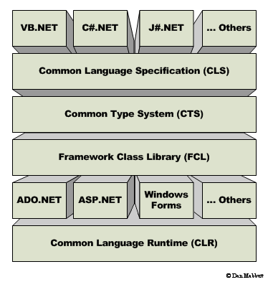
.NET Architecture

Slide 4
.Net Languages
4
.NET supports multiple languages such as C#, VB.Net, J# .Net, ASP.NET, JSCRIPT.NET and other languages. There are currently 44 languages supported by .NET Framework 4.0.
Notes:
4

Slide 5
Common Language Specification(CLS)
Common Language Specification (CLS) is a set of basic language features that .Net Languages needed to develop Applications and Services. It is a subset of Common Type System(CTS) which unites all languages to one platform and helps in communicating with other .Net Languages. It is more beneficial for Developers who can access and review code of others when required. When developers design publicly accessible APIs following the rules of the CLS, those APIs are easily used from all other programming languages that target the Common Language Runtime.

Slide 6
Common Type System(CTS)
The common type system defines how types are declared, used, and managed in the runtime, and is also an important part of the runtime's support for cross-language integration. The common type system performs the following functions:
Establishes a framework that helps enable cross-language integration, type safety, and high performance code execution.
Provides an object-oriented model that supports the complete implementation of many programming languages.
Defines rules that languages must follow, which helps ensure that objects written in different languages can interact with each other.

Slide 7
Framework Class Library(FCL)
It is a standard Library of Microsoft .Net Framework. The FCL is a collection of thousands of reusable classes (within hundreds of namespaces), interfaces and value types.It is similar to “package” in Java.The .NET Framework's Base Class Library provides user interface, data access, database connectivity, cryptography, web application development, numeric algorithms, and network communications. Programmers produce software by combining their own source code with the .NET Framework and other libraries. The .NET Framework is intended to be used by most new applications created for the Windows platform.

Slide 8
Database and Web Applications
ADO.NET is used for database connectivity. There are five components used in ADO.NET such as Dataset, Connection, Command, Data Reader and Data Adapter objects which are used for data manipulation.
ASP.NET is used for developing Web based Applications.
WinForms are mainly used for Windows Applications.

Slide 9
Common Language Runtime(CLR)
The .NET Framework provides a run-time environment called the common language runtime, which runs the code and provides services that make the development process easier. The Common Language Runtime is the execution engine for .NET Framework applications. It provides a number of services, including the following:
Code management (loading and execution)
Application memory isolation
Verification of type safety
Conversion of IL to native code
Access to metadata (enhanced type information)
Managing memory for managed objects
Enforcement of code access security
Exception handling, including cross-language exceptions
Interoperation between managed code, COM objects, and pre-existing DLLs (unmanaged code and data)
Automation of object layout
Support for developer services (profiling, debugging, and so on)

Slide 10
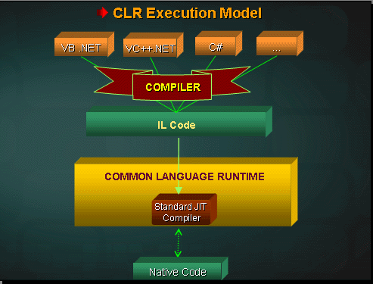
CLR Model

Slide 11
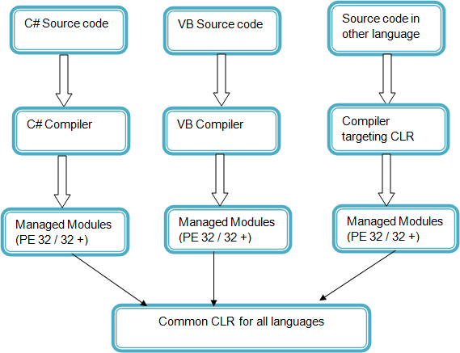
Managed Module

Slide 12
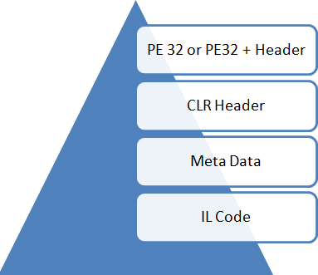
Components of Managed Module

Slide 13
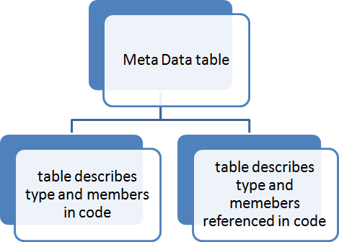
MetaData

Slide 14
REFERENCES
http://en.wikipedia.org/wiki/List_of_CLI_languages
http://arunmicrosystems.netfirms.com/clr.html
http://www.dotnetuncle.com/Framework/34_CLR.aspx
http://www.dotnetspark.com/qa/2483-what-is-clscommon-language-
specification.aspx
http://msdn.microsoft.com/en-us/library/27y4ybxw%28v=vs.71%29.aspx
http://www.w3schools.com/aspnet/default.asp

Slide 15
Thank You
Notes:
Guidelines
The Program Review (PMR) is conducted monthly for all key functions to provide visibility to the Sr.Mgmt on the progress, performance, trends, risks and issues of the functions; the review is done against the function objectives, goals and plans; it helps the team and other stakeholders to take any course correction.
The Program review is held by the Function Head. Participants include the whole functional team.
The program review inputs (PPT/Report, support documents) to be circulated to all the participants in advance by the Function manager.
Participants are expected to come prepared for the meeting with specific queries/updates/resolution (for effective utilization of meeting time)
The recommended duration for program review is not more than 1 hour
The action item arising out of the Program review is recorded as part of the program review PPT and circulated to all the participants by the Function Manager
Function Manager tracks to closure the identified action items.
The Program review schedule will be published in the Intranet during the last week of every month and status updated periodically by QA.

